Slide 1
NopCommerce Automation
Team Xpendables

Slide 2


Introduction
This is a Hands-On Demonstration of the capabilities of Automation in enhancing and improving our experience specifically for our Project.

Slide 3
Agenda
Defining Automation
User Scenarios
Prioritization and Development
ROI

Slide 4
Defining Automation

Slide 5


Automation
For NopCommerce, Automation means the execution of test cases in form of scripts written by Testers. These scripts are developed, executed, and monitored to increase efficiency and reduce time consumption of Manual Test Execution, thus allowing for other aspects of the project to get more attention

Slide 6
What to Expect?
Benefits
Responsibilities
Increases test execution speed and coverage.
Reusability of scripts on other applications with similar functionality.
Reporting and Sharing Test Progress Status easier than ever
Saving Time, Effort & Cost
Initial time added to the Project Timeline for script development
Proficiency is needed so it won’t be a walk in the park

Slide 7
User Scenarios

Slide 8
RoadMap
Identify Key Functions
Track Frequent Workflows done on website
Create Feature
Prioritize Features
Develop Test Scenarios
1
2
3
4
5

Slide 9
Prioritization & Development

Slide 10
Prioritization
 | Critical Functionality | User Experience | Frequency of Use | Complexity and Dependencies | Business Impact | Total / 5
U-S-1 | 10 | 7 | 8 | 5 | 8 | 7.6
U-S-2 | 5 | 9 | 10 | 4 | 7 | 6
U-S-3 | 7 | 5 | 2 | 8 | 6 | 5.6
U-S-4 | 5 | 8 | 8 | 3 | 5 | 5.8

Slide 11
Tool Selection

Slide 12
Why Choose Cucumber
Business-Readable Tests:
Cucumber allows writing test scenarios in a human-readable format using Gherkin syntax. This enables collaboration between technical and non-technical stakeholders ,promoting better understanding and alignment on requirement and test coverage.
2. Behavior-Driven Development Approach:
Cucumber promotes BDD practices by focusing on behavior and business outcomes rather than technical implementation details. This ecourages a shift-left approach to testing, fostering early collaboration and reducing miscommunication between development and QA teams.
3. Reusability and Maintainability:
Cucumber support reusable step definitions, allowing test scenarios to be modular and maintainable. This enhances test scalability and reduces duplication across test suites, optimizing test maintenance efforts.
4. Test Automation and Documentation in One:
With Cucumber, automated tests serve as living documentation, reflecting the intended behavior of the application. This minimize the gap between test cases and actual system behavior, ensuring accurate and up-to-date test coverage.

Slide 13
Benefits of Using Cucumber for Website Testing
Cross-Funtcion Collaboration::
Cucumber fosters collaboration between business analysts, developers, testers, and stakeholders through shared understanding of feature behavior. This alignment reduces misunderstandings and accelerates feedback loops.
2. Enhanced Test Coverage and Clarity:
By defining clear, structued test scenearios in Gherkin syntax, Cucumber favilitates comperhensive test coverage and clarity of business requirements. This clarity leads to more effective test planning and execution.
3. Improved Test Traceability and reporting:
Cucumber provides builkt-in reporting capabilities and integrations with CI/CD piplines, enabling test execution visibility and traceability. Detailed test reports and metrics empower teams to make data-driven decisions for quality improvement.
4. Continuous Integration and Delivery (CI/CD) Support:
Cucumber seamlessly integrates with CI/CD tools to automate test execution and enable continuous testing practices. This accelerates feedback cycles and support agile development workflow.

Slide 14
Return on Investment

Slide 15
ROI
Time Saving:
Reduced testing cycle times and faster feedback loops.
Reallocation of manual testing efforts towards higher-value tasks.
2. Quality Improvements:
Enhanced test coverage and reliability of test results.
Reduction in defect escape rates and production issues.
3. Scalability and Reusability:
Ability to execute tests across multiple configurations and platforms.
Leveraging reusable test components and libraries.
4. Cost Savings:
Reduction in regression testing efforts and associated labor costs.
Quantifiable savings in manual testing efforts over time.

Slide 16
Time
 | Testing Time | dev script | Time saved
1 | 80 | 32 | -32
2 | 76 | 32 | -60
3 | 72 | 32 | -84
4 | 68 | 32 | 104
5 | 64 | 32 | -120
6 | 60 | 32 | -132
7 | 56 | 32 | -140
8 | 52 | 32 | -144
9 | 48 | 32 | -144
10 | 44 | 32 | -140
11 | 40 | 32 | -132
12 | 36 | 32 | -120
13 | 32 | 32 | -104
14 | 28 | 32 | -94
15 | 24 | 32 | -82
16 | 20 | 32 | -70
17 | 16 | 32 | -58
18 | 12 | 0 | 10
19 | 12 | 0 | 78
20 | 12 | 0 | 146
21 | 12 | 0 | 214
22 | 12 | 0 | 282
23 | 12 | 0 | 350
24 | 12 | 0 | 418
Scenarios = 9
Script Development time = 32
Development time per scenario= 3.64~4
BreakEven after 18 Months
Hrs saved after 24 Months = 418 ~ 10+ Weeks

Slide 17
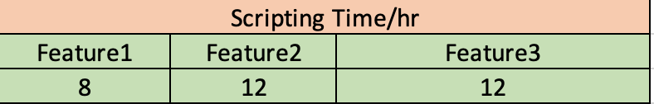
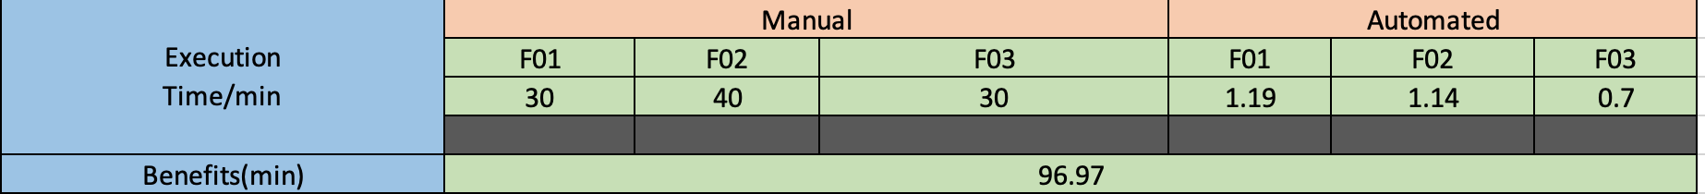
Cost
1. Scripting Time/hr
2. Execution Time/min

Slide 18
Cost
1. Calculations
2. ROI

Slide 19
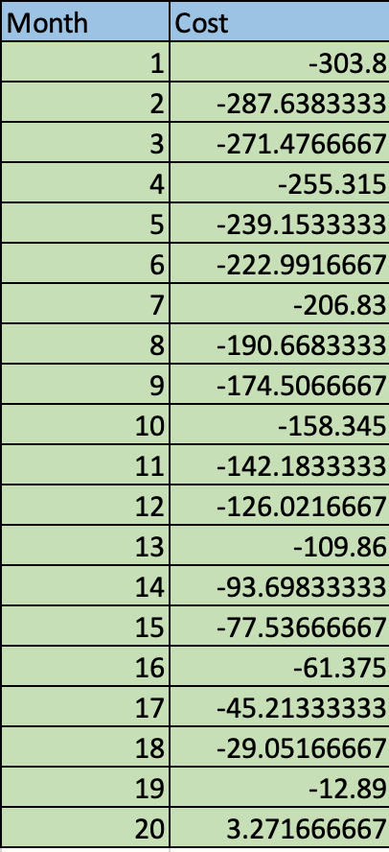
Cost
Scenarios = 9
Script Development time = 32
Development time per scenario= 3.64~4
BreakEven after 19 Months
Cost saved after 19 Months = $307

Slide 20
Summary
Although Automation maybe costly initially, but its perks always outshines the obstacles and proves it’s an exceptional solution, to a rapidly growing business.

Slide 21
Thank you
Any Questions?

